Slide 1
Source Code Control

Slide 2
Source Code Control
Refer to QOP-42-10 Software Development Lifecycle for policies
We currently have 3 different source code repositories: Visual SourceSafe (VSS) , Team Foundation Source Control (TFSC) and GIT
All new projects use TFSC or GIT
VSS projects must be migrated to TFSC prior to further development

Slide 3
VSS environment
VSS databases are located on the \\reedtech.com\tech\Dev_VSS volume
VSS is accessible via a shared virtual machine
VSS is used for historical purposes and is not to be edited except to update the project name with a “Now-In-TFS-”prefix after migration to TFSC

Slide 4
TFSC or GIT
Integrates with Visual Studio
Supports check-in, check-out, and version labeling
Utilizes Windows authentication (no separate login needed)

Slide 5





Team Foundation Server
Integrated Platform for Collaborating on Software Development Projects.
Work Item Tracking
Source Code Control
Reporting
Build Automation
Team Communications

Slide 6
Team Foundation Server
This document focuses only on the source code control component of TFS.
Source code can be viewed with TFS Web Access or the Source Code Explorer in Visual Studio.

Slide 7
TFS – Visual Studio
ReedTech is using TFS 2017
Visual Studio 2017 or higher can be used to connect to TFS

Slide 8
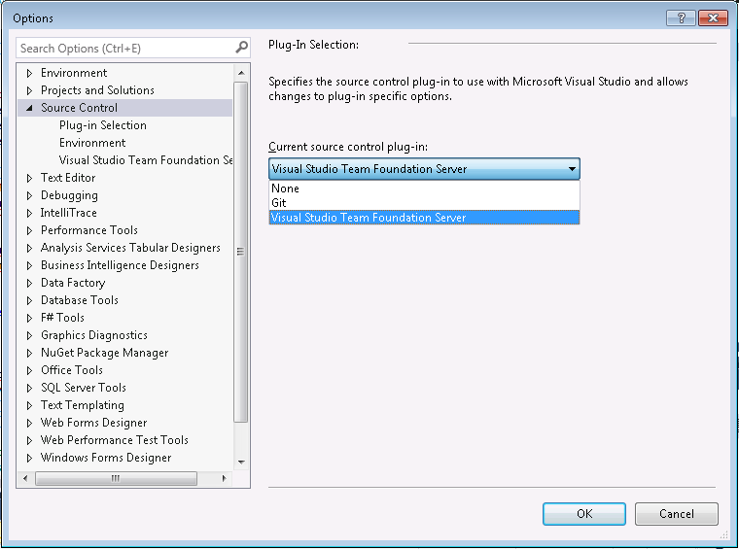
Visual Studio – TFSC Provider
Need to choose the correct plug-in under
Tools | Options | Source Control:

Slide 9
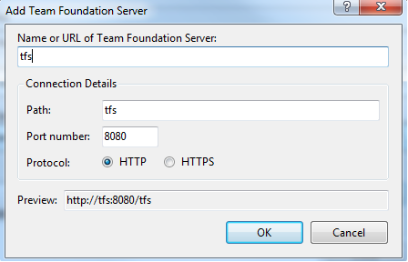
TFSC – Connect to TFS server
From the Team explorer in Visual Studio, click manage connections to add new connection and simply type tfs as the server name

Slide 10
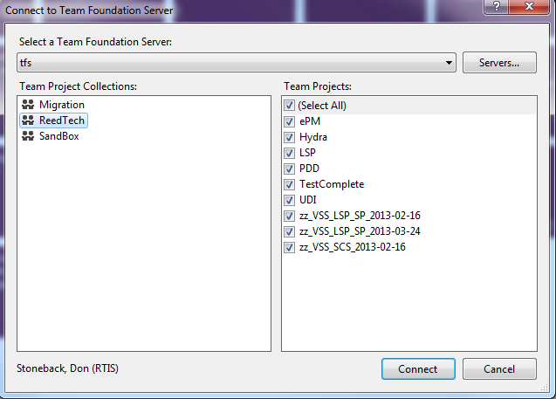
TFSC – Connect to Team Projects
Select the Team Collection and Project(s) you want to work on
  You will only see the Projects that you are a member of

Slide 11
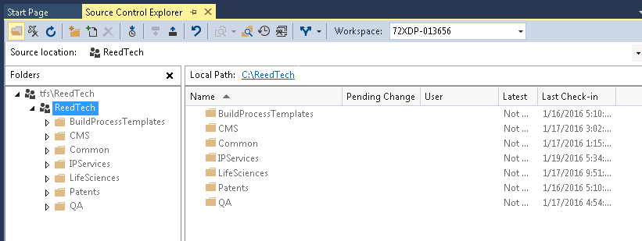
TFSC – setting Local Path
Recommendations:
  Start at a top level near the root (e.g., not buried under the Users … folder)
  Map the collection level (…\ReedTech), then all subprojects/folders will inherit that path.

Slide 12
TFS Source Control
Key Concepts
  Changesets
    Integrated Check-in
    Check-in Policies
  Workspaces
  Shelving

Slide 13
TFS Source Control
Other concepts
  Labeling
  Compare/Diff
    Annotation
  Branching & Merging

Slide 14
TFSC Changesets
Logical container of data related to check-in
File and branch information
Uniquely identified
Numeric identifier
Represents a point in time of source repository
Links to work items
Check-in notes
Comment
Policy compliance
Metadata (date, time, user)
Unit of atomic check-in
Incremental

Slide 15
TFSC Integrated Check-in
Atomic
A changeset is guaranteed to have all changes from a check-in
Integrated
Check-in policy applied (but override-able)
Work Items associated
Builds associated with Work Items
Check-in notes
All related to changeset
Pending Check-in Window
Notification possibilities
Check-in Policy
Customizable, extensible

Slide 16
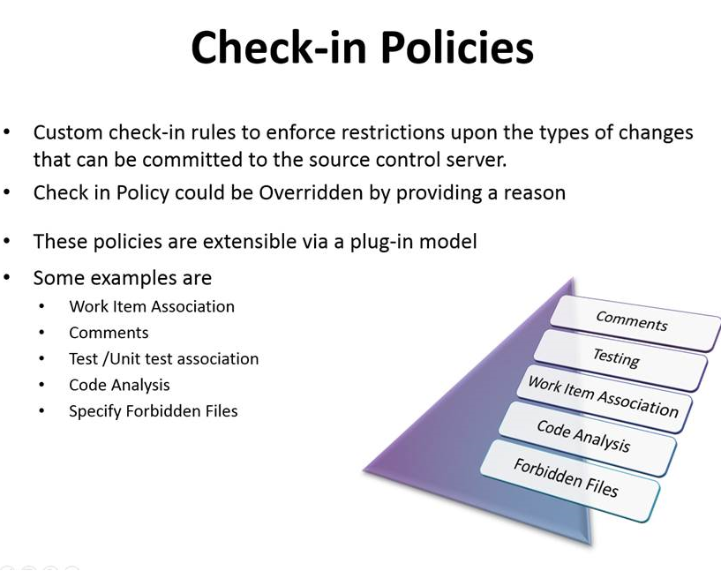
Check-in Policies

Slide 17

TFSC Workspaces
Client side copy of source retrieved from repository
Owned by one user on one machine
Changes in workspace create pending changes
Workspace mapping = Repository folder mapped to local folder

Slide 18







TFSC Shelving
Set aside pending changes without check-in
  Optionally revert to unmodified files
  Restore shelved changes by “un-shelving”
  Un-shelve other user’s changes
Power of task branching with less overhead
Scenarios
Switch Tasks
Backup
Work-In-Progress
Checkpoint
Work-In-Progress
Developer
Share
Work-In-Progress
Perform a Code Review

Slide 19
Using Git with Visual Studio
Please review the department Wiki page to utilize Git with Visual Studio.
Using Git Wiki Link

